Slide 1
FARS Data Set
Analysis and Visualization

Slide 2

What is it?
The program collects data for analysis of traffic safety crashes to identify problems, and evaluate countermeasures leading to reducing injuries and property damage resulting from motor vehicle crashes.
Contains Accident Information on
Date
Weather
Person
Vehicle
Location

Slide 3

Methods and Work
Cleaning and Wrangling of more than 100 coded elements
600 page catalogue to decode
Understanding the method of data collection
Finding the key elements for Exploratory Data Analysis
Visualizing the right information

Slide 4
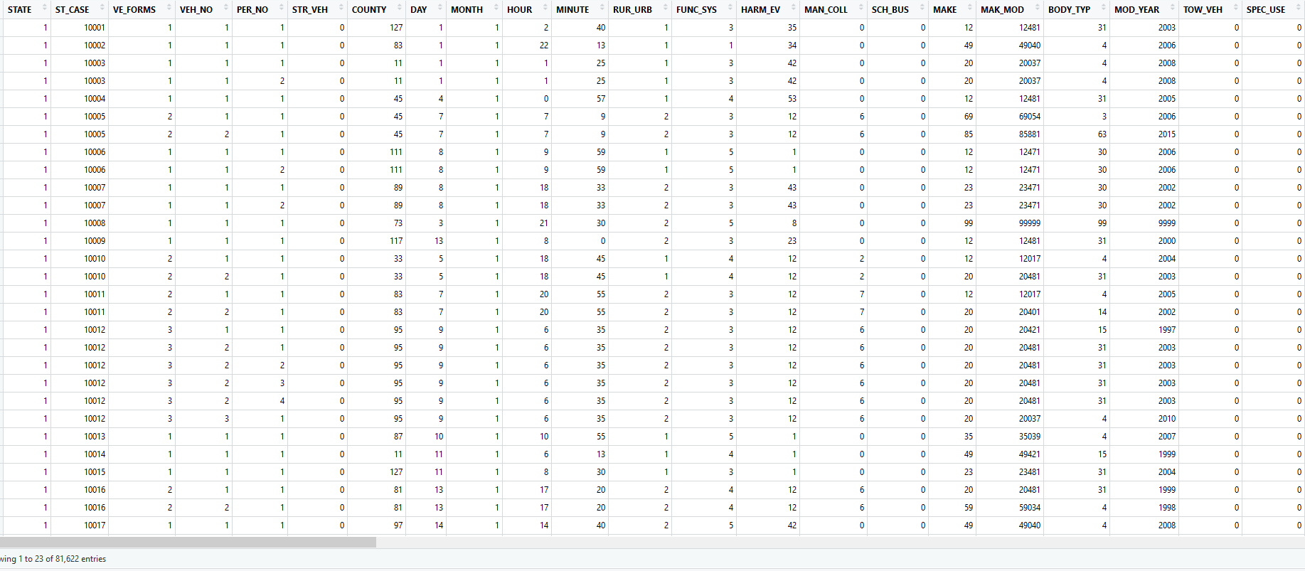
Raw Data

Slide 5
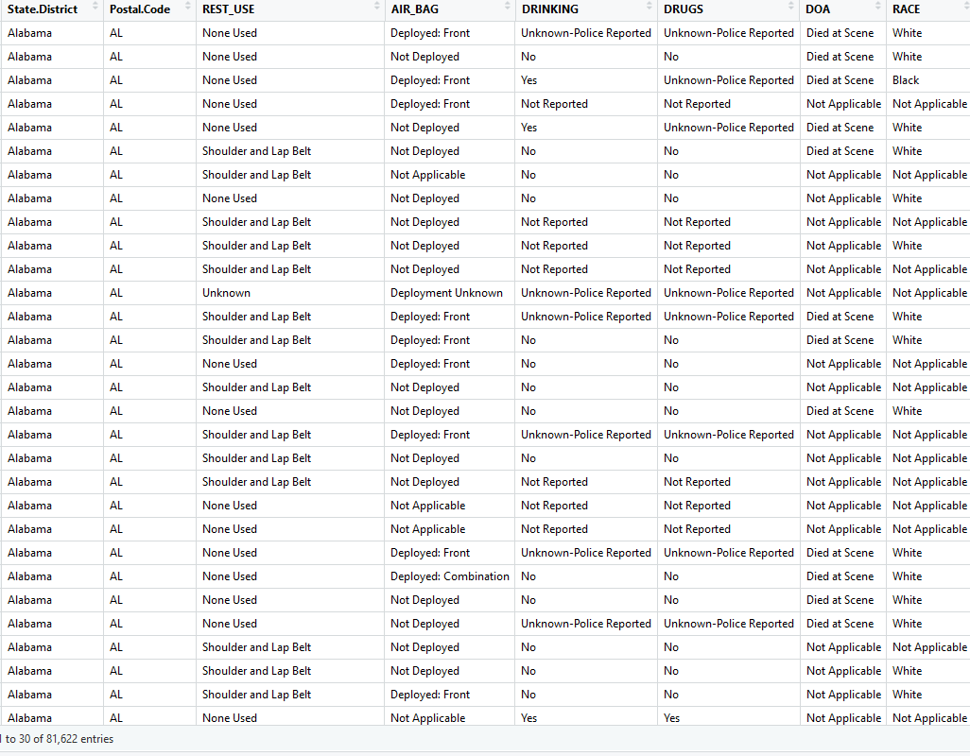
Cleaned Data

Slide 6

Findings
The data gives a lot of insight into multiple variables playing a role in the crash
By visualizing more than 50 factors, here are some of the most impactful one’s

Slide 7
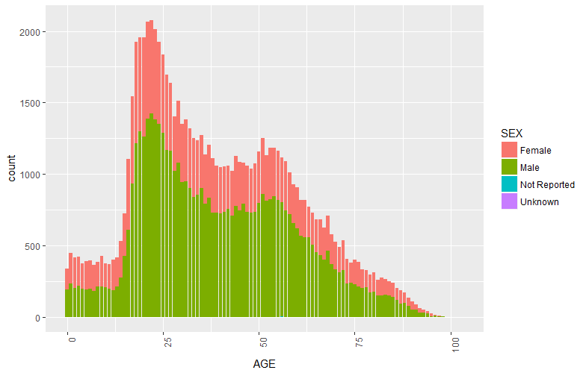
Age
Overs the years trends have been showing increase in accident rate in age group of 65 years and above
Aging population?

Slide 8
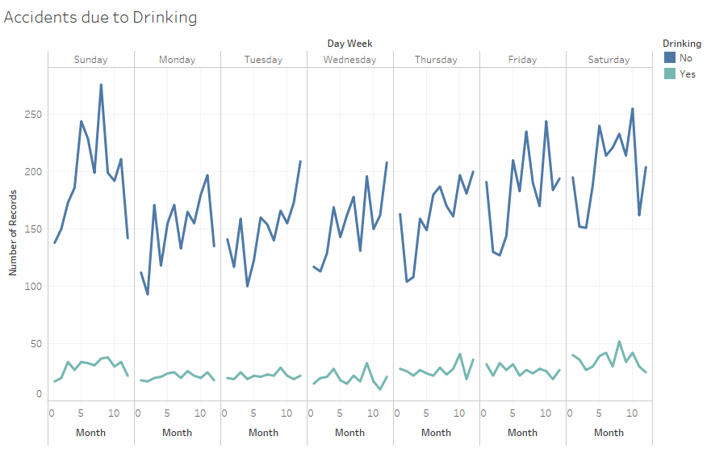
Accidents due to Drinking
Note: The high rate of accident on Saturdays and Sundays but surprisingly in the non drinking category
Notes:
Due to reduced traffic high speeds may be leading to more accidents

Slide 9
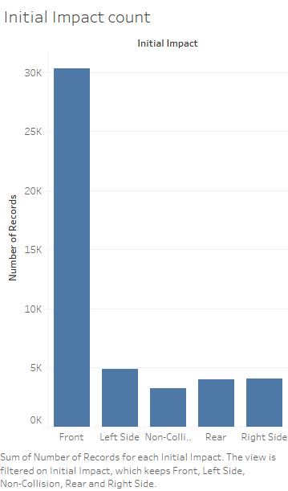
Initial Impact
An unlikely inference can be made from this data
We can see that sitting on the rear right side of the car will be most safest for initial impacts (given that the seat belt is fastened)
This is purely a inference and many other data points needs to be collected in order to verify and prove the claim

Slide 10
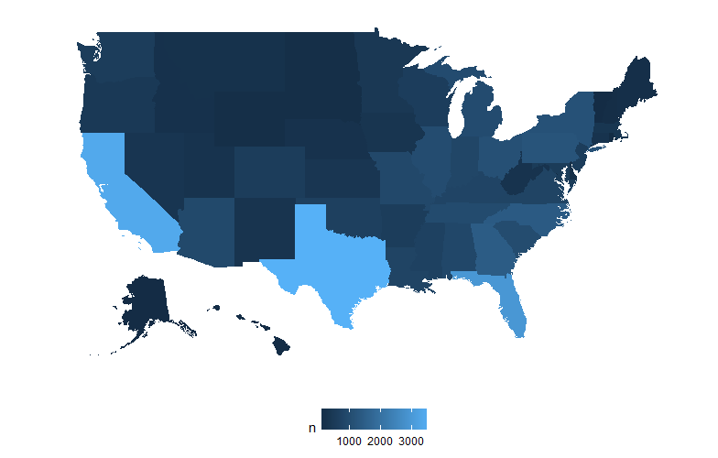
How do the States fair?

Slide 11
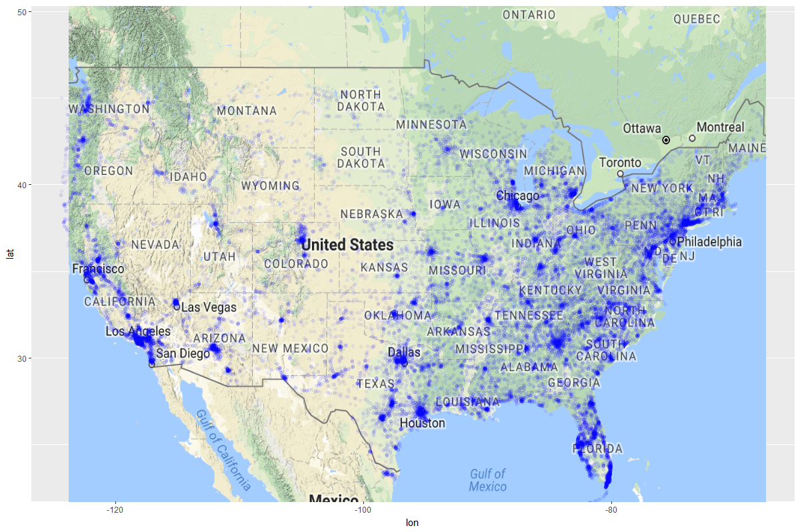
Better View

Slide 12
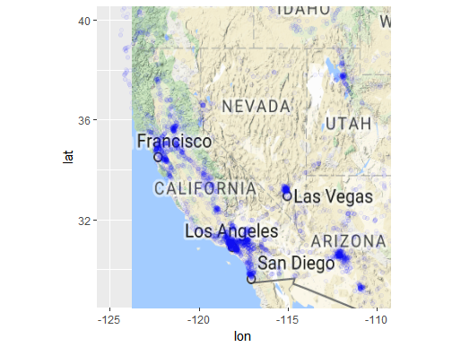
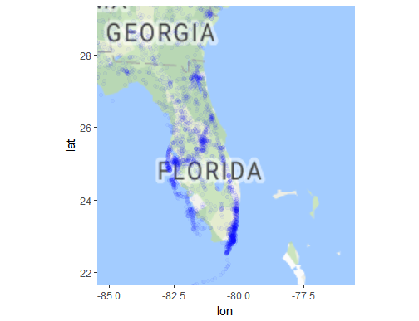
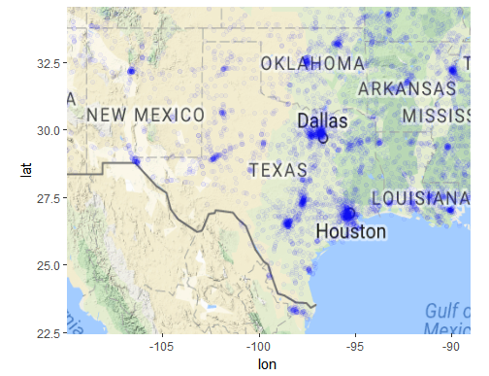
California, Florida and Texas

Slide 13

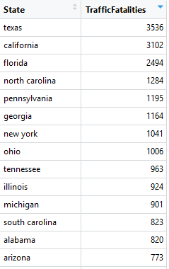
Accident Numbers per state
Is it telling us everything?

Slide 14
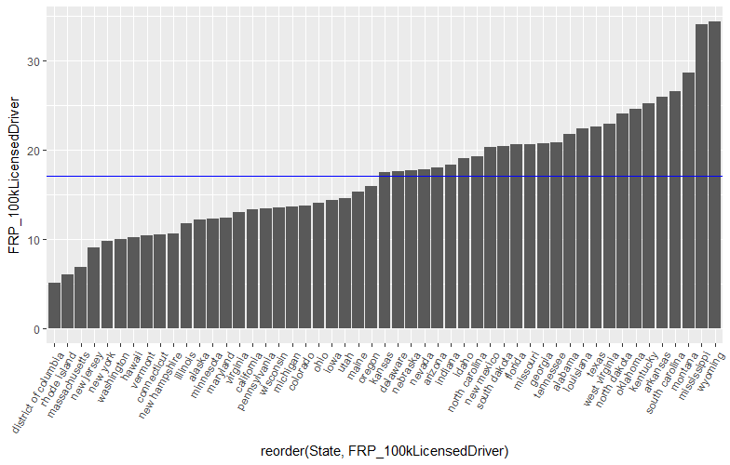
Fatalities per 100,000 licensed drivers

Slide 15
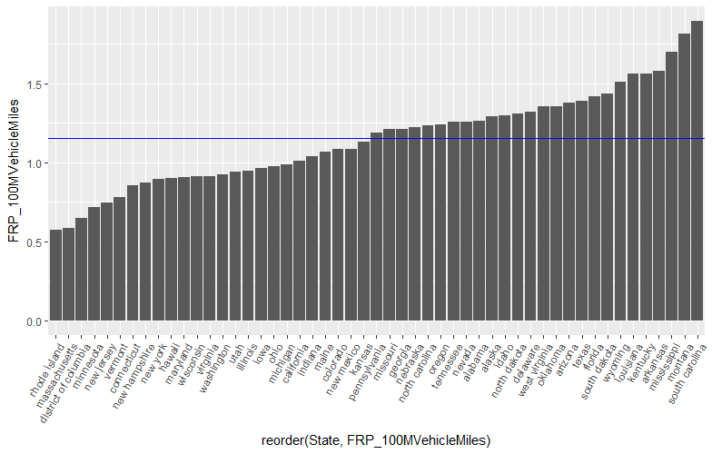
Fatalities per 100 million miles travelled
Rhode Island and Massachusetts have the most safest drivers. Really??

Slide 16
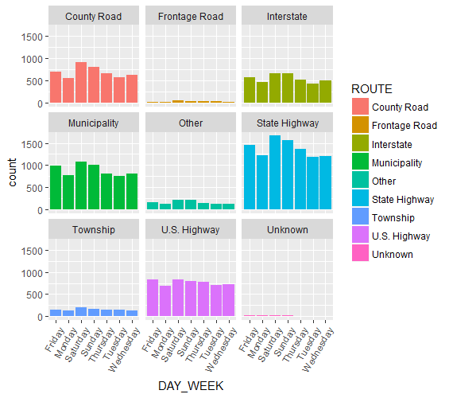
Which route to take on which day?

Slide 17

Reasons

Slide 18
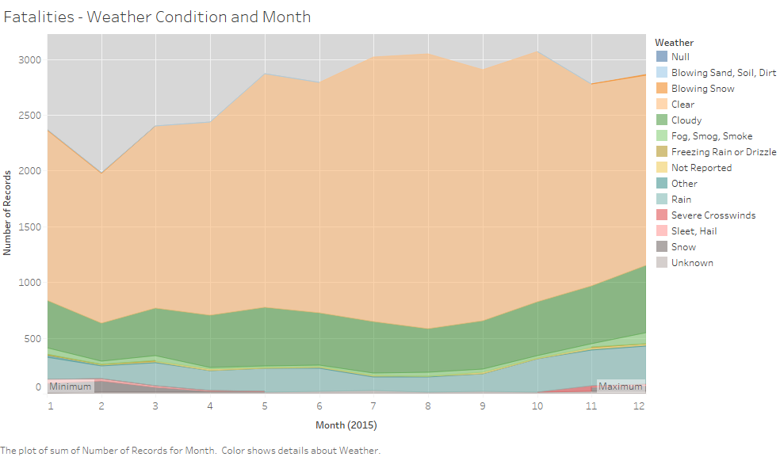
Weather Condition?

Slide 19
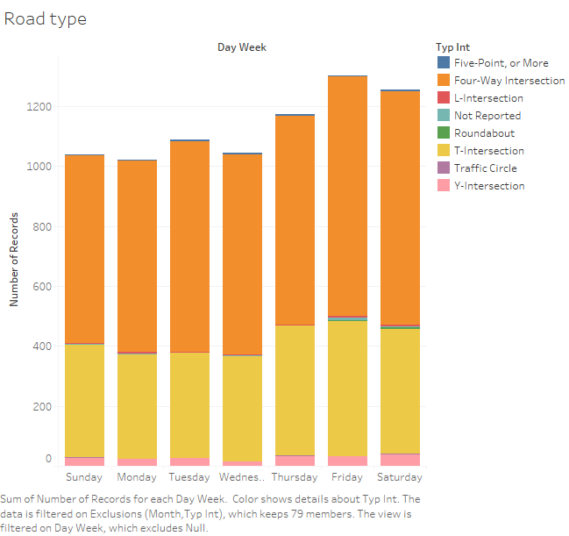
Road Type?
Notes:
To reduce accidents
Installing Speed breakers
Police Presence
Speed Camera

Slide 20
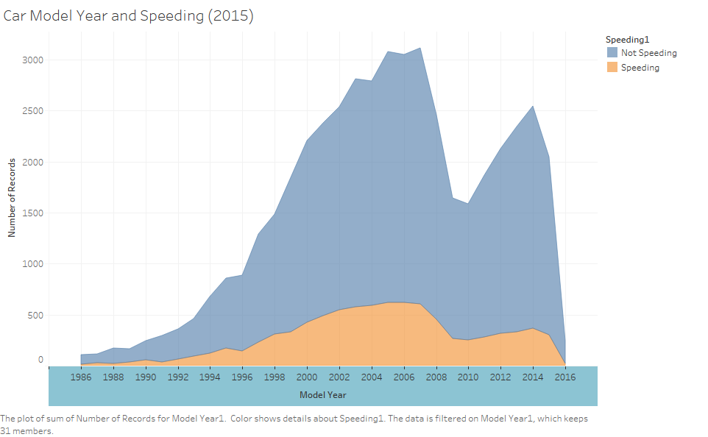
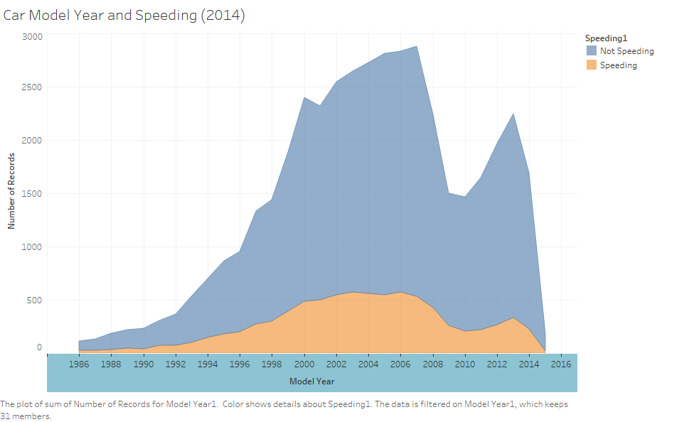
May be Car Model Year?

Slide 21

Conclusions
Need to increase surveillance of accident prone areas by thorough analysis of the heat map
Increase in safety checks of cars which are in the age bracket of 8-17 years
Higher police presence and installation of speed cameras in Four-Way Intersection and T-Intersection
Run driver education campaigns in Mississippi, Montana, South Carolina and, Wyoming to tackle the high rate of incidence
Also major policy changes need to be implemented in California, Florida and, Texas with respect to Speed restriction and heavier fines

Slide 22

Take Away
The devil is in the details
Could have looked into more data which included injuries and other incidence reports
Every situation in unique and the categorization of data has to be more complex
Generalized lot of data to simplify the visualization
By toning the data down to specific roads which have higher accident rates we can suggest detailed plans to reduce the rate
Additional Years could give us information on various trends and accurate insights

Slide 23

Thank You

